Slide 1
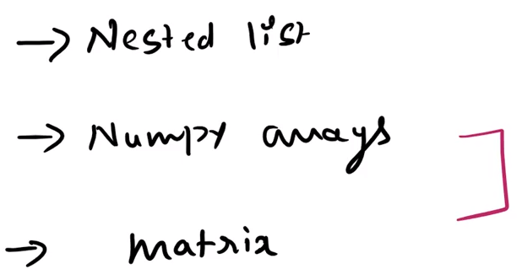
https://www.youtube.com/watch?v=X5BX0B-YAC0
Matrix
In NumPy library there are many pre defined functions which we can use to perform different operations. That’s why
Adding, multiplying & transpose matrix is not difficult here. But performing these operations without using NumPy library
On matrix is little bit trick here.

Slide 2
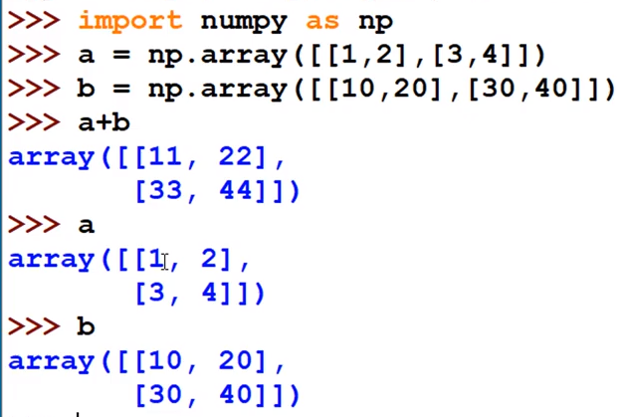
Matrix Addition
Both Array addition & Matrix addition uses symbol +

Slide 3
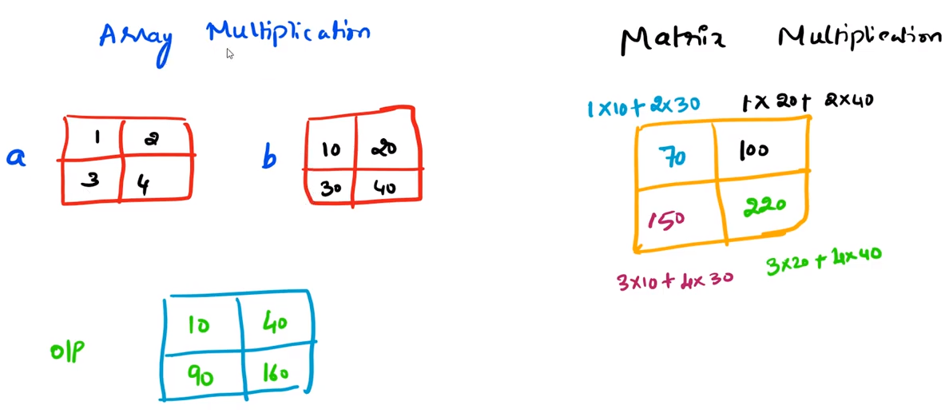
Matrix Multiplication
Array Multiplication uses symbol *
Matrix Multiplication uses symbol *
2*20
1*10
3*30
4*40

Slide 4
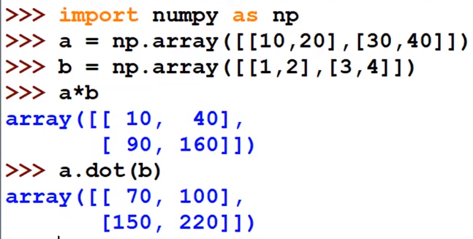

Slide 5
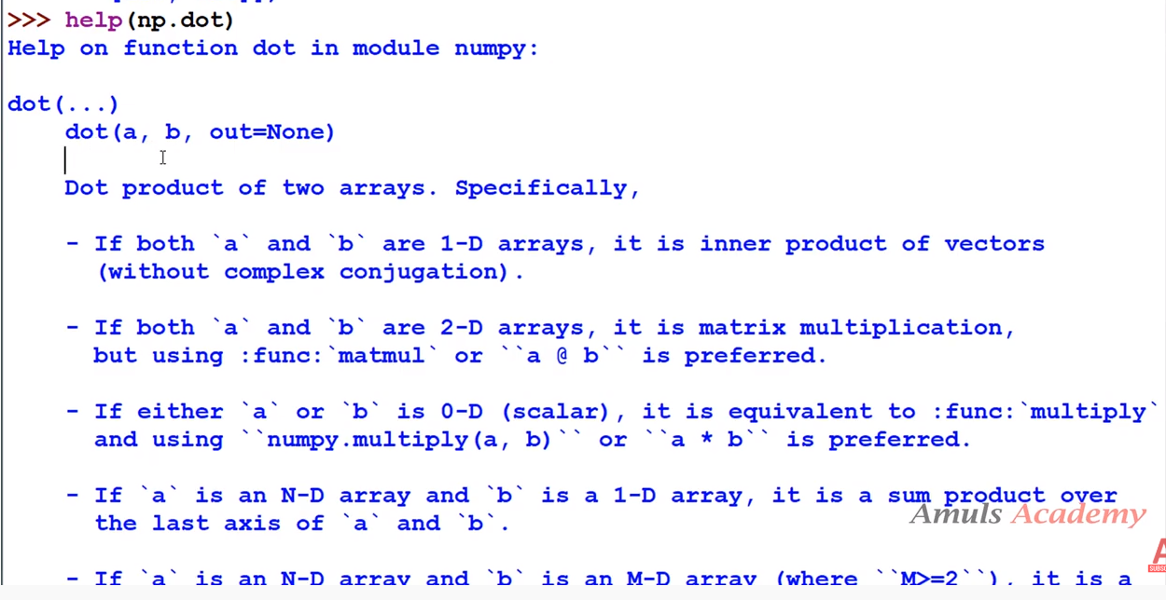

Slide 6
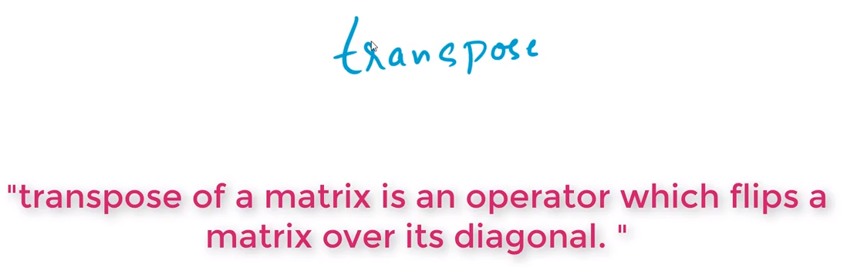
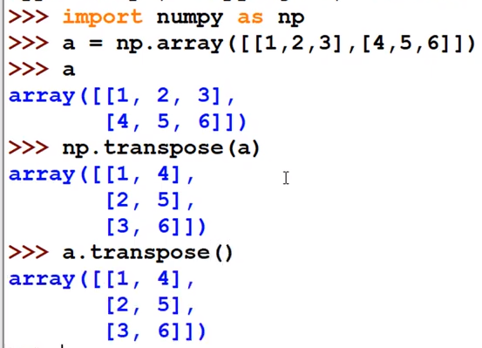

Slide 7
1. what is the difference between matrix VS arrays?
Matrix are 2 dimensional.
Arrays can be 1d 2d 3d .....nd.
2. What is the best IDE for python..?
PyCharm
Spyder
IDLE

